Slide 1

Naïve Bayesian Classifier

Slide 2
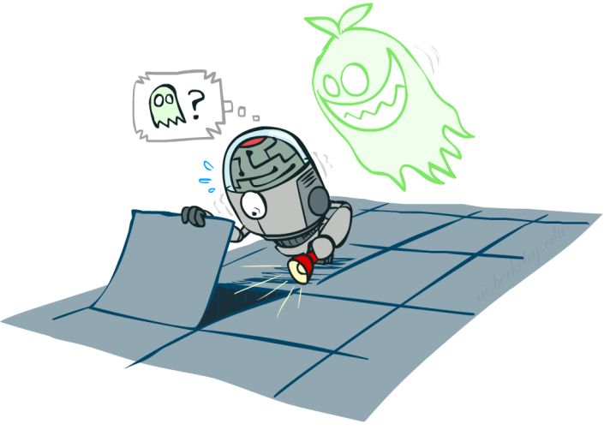
Probabilistic Models
A probabilistic model is a joint distribution over a set of random variables
Probabilistic models:
  (Random) variables with domains
  Assignments are called outcomes
  Joint distributions: say whether assignments (outcomes) are likely
  Normalized: sum to 1.0
  Ideally: only certain variables directly interact
We will not be discussing Independent events, and Mutually Exclusive events
Distribution over Temp , Weather
T | W | P
hot | sun | 0.4
hot | rain | 0.1
cold | sun | 0.2
cold | rain | 0.3

Slide 3
Main Types of Probability (discussed here)
Joint Probability
  The probability of two (or more) events is called the joint probability. The joint probability of two or more random variables is referred to as the joint probability distribution.
  P(A and B) = P(A given B) * P(B)
Marginal Probability
  The probability of one event in the presence of all (or a subset of) outcomes of the other random variable is called the marginal probability or the marginal distribution.
  P(X=A) = sum P(X=A, Y=yi) for all y
Conditional Probability
  The probability of one event given the occurrence of another event is called the conditional probability.
  P(A given B)= P(A|B) = P(A and B)/P(B)

Slide 4
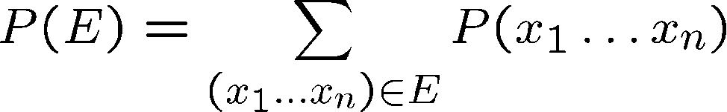

Events
An event is a set E of outcomes
From a joint distribution, we can calculate the probability of any event
  Probability that it’s hot AND sunny?
  Probability that it’s hot?
  Probability that it’s hot OR sunny?
Typically, the events we care about are partial assignments, like P(T=hot)
T | W | P
hot | sun | 0.4
hot | rain | 0.1
cold | sun | 0.2
cold | rain | 0.3

Slide 5
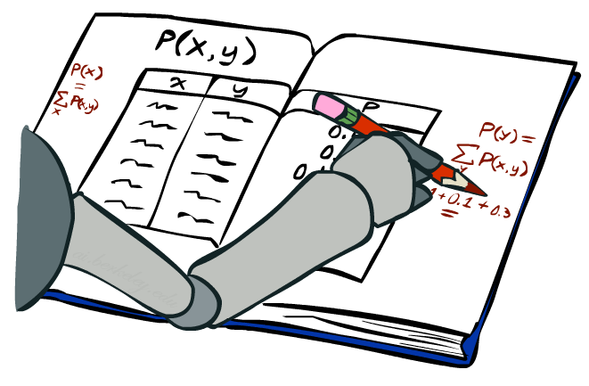

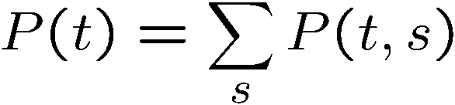

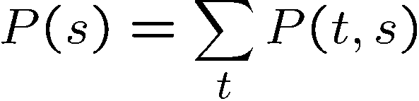
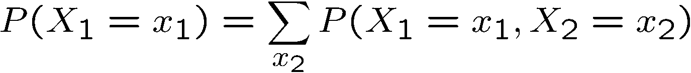
Marginal Distributions
Marginal distributions are sub-tables which eliminate variables
Marginalization (summing out): Combine collapsed rows by adding
T | P
hot | 0.5
cold | 0.5
T | W | P
hot | sun | 0.4
hot | rain | 0.1
cold | sun | 0.2
cold | rain | 0.3
W | P
sun | 0.6
rain | 0.4

Slide 6
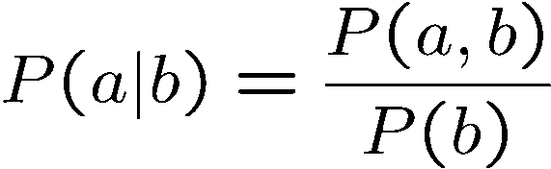
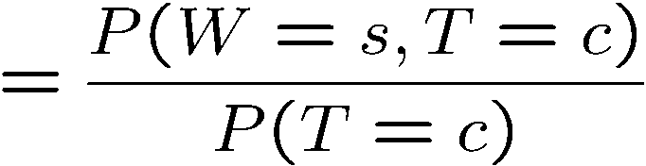
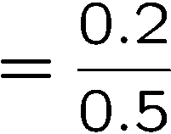



Conditional Probabilities
A simple relation between joint and conditional probabilities
  In fact, this is taken as the definition of a conditional probability
P(a,b)
P(a)
P(b)
T | W | P
hot | sun | 0.4
hot | rain | 0.1
cold | sun | 0.2
cold | rain | 0.3

Slide 7



The Product Rule
Example:
D | W | P
wet | sun | 0.1
dry | sun | 0.9
wet | rain | 0.7
dry | rain | 0.3
D | W | P
wet | sun | 0.08
dry | sun | 0.72
wet | rain | 0.14
dry | rain | 0.06
R | P
sun | 0.8
rain | 0.2

Slide 8
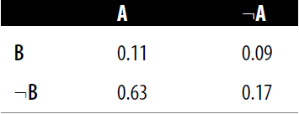
Joint probability Distribution
A joint probability distribution can be used to represent the probabilities of combined statements, such as A ∧ B.
The following table shows a joint probability distribution of two variables, A and B:
Find the following:
  P(A) & P(B)
  P(A ∨ B)
  P(￢A ∧ ￢B)
  P(B|A)

Slide 9
Joint probability Distribution
P(A) = 0.11 + 0.63 = 0.74.
P(B) = 0.11 + 0.09 = 0.2.
P(A ∨ B) = 0.11 + 0.09 + 0.63 = 0.83
P(￢A ∧ ￢B) = 0.17
P(￢A ∧ ￢B) = 1- P(A ∨ B) = 1 - 0.83 = 0.17.
P(B ∧ A) = 0.11 and P(A) = 0.11 + 0.63 = 0.74, so P(B|A) = 0.11 / 0.74 = 0.15.

Slide 10
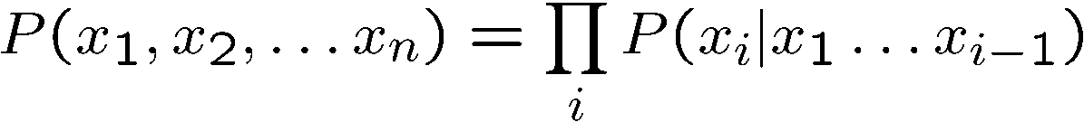
The Chain Rule
More generally, can always write any joint distribution as an incremental product of conditional distributions

Slide 11
Probabilistic Reasoning
Probability theory is used to discuss events, categories, and hypotheses about which there is not 100% certainty.
Analyzing logical statements does not function in situations that are lacking certainty.
For example, we might write A→B
  which means that if A is true, then B is true.
If we are unsure whether A is true, then we cannot make use of this expression.
In many real-world situations, it is very useful to be able to talk about things that lack certainty.
  For example, what will the weather be like tomorrow?

Slide 12
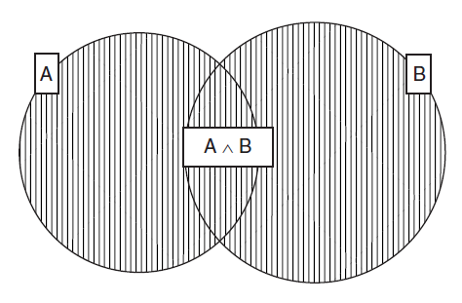
Probabilistic Reasoning
We might formulate a very simple hypothesis based on general observation, such as “it is sunny only 10% of the time, and rainy 70% of the time.”
  P(S) = 0.1
  P(R) = 0.7
A probability of 0 means “definitely not” and a probability of 1 means “definitely so.” Hence, P(S) = 1 means that it is always sunny.
  P(A ∨ B) = P(A) + P(B) - P(A ∧ B)

Slide 13
Bayes Classifiers
Bayesian classifiers use Bayes theorem:
$$P\left(C | F \right)=\frac{P\left(F|C\right)×P(C)}{P\left(F\right)}$$
$P\left(C | F \right)$: Probability of instance F being in class C,
  This is what we are trying to compute
$P\left(F|C\right)$: Probability of generating instance F given class C,
  We can imagine that being in class C, causes you to have feature F with some probability
P(C): probability of occurrence of class C,
  This is just how frequent the class C, is in our dataset
P(F): probability of instance F occurring
  This can actually be ignored, since it is the same for all classes

Slide 14
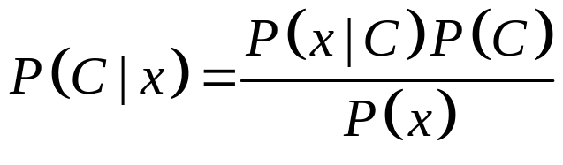
Bayes Classifier
Givem feature points: we want to compute class probabilities using Baye’s Rule:
More Formally
$$posterior=\frac{Class Likelihood ×Prior}{Evidence}$$
  $P\left(C\right)$ : prior probability.
  $P\left(x\right)$ : probability of $x$.
  $P\left(x | C\right)$ : conditional probability of $x$ given $C$: likelihood
  $P\left(C|x\right)$ : conditional probability of $C$ given $x$: posterior probability

Slide 15
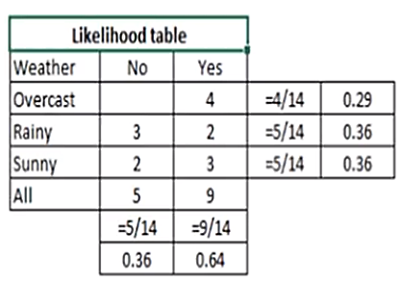
Example
Weather | Play
Sunny | No
Overcast | Yes
Rainy | Yes
Sunny | Yes
Sunny | Yes
Overcast | Yes
Rainy | No
Rainy | No
Sunny | Yes
Rainy | Yes
Sunny | No
Overcast | Yes
Overcast | Yes
Rainy | No
Problem:
  Player will play or not if the weather is sunny?

Slide 16
Example
We can solve it using above discussed method of posterior probability.
$$P\left(Yes | Sunny\right)=\frac{P\left(Sunny | Yes\right)∗P\left(Yes\right)}{P\left(Sunny\right)}$$
Here we have
  $P\left(Sunny | Yes\right)=\frac{3}{9}=0.33$
  $P\left(Sunny\right)=\frac{5}{14}=0.36$
  $P\left(Yes\right)=\frac{9}{14}=0.64$
Now
  $P\left(Yes | Sunny\right)=\frac{0.33∗0.64}{0.36}=0.60$
Similarly we will calculate for $P\left(No | Sunny\right)$

Slide 17
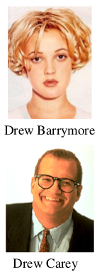

Assume that we have two classes
c1 = male, and c2 = female,
and only one feature F: name
We have a person whose gender we do not know, say “drew” or F.
Classifying drew as male or female is
equivalent to asking: is it more probable that drew is male or female, i.e. which is greater?
p(male | drew) or p(female | drew)
(Note: “Drew”
can be a male or female name)
What is the probability of being called “drew” given that you are a male?
(actually irrelevant, since it is that same for all classes)

Slide 18
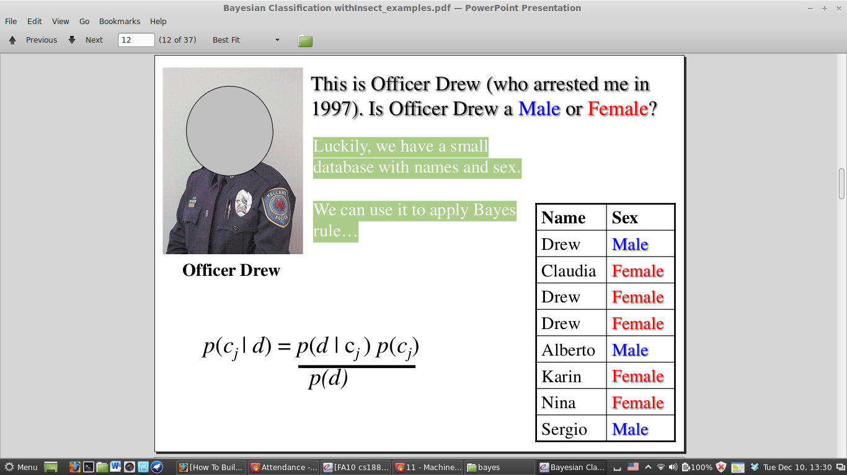
This is Officer Drew. Is Officer Drew a Male or Female?
Luckily, we have a small database with names and gender.
We can use it to apply Bayes rule...
$$P\left(C | F \right)=\frac{P\left(F|C\right)×P(C)}{P\left(F\right)}$$

Slide 19
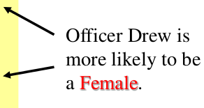
$$P\left(C | F \right)=\frac{P\left(F|C\right)×P(C)}{P\left(F\right)}$$
$P\left(male | drew \right)=\frac{P\left(drew | m\right).P(m) }{P(drew)}=\frac{1/3×3/8}{3/8}$=$\frac{1}{3}$
$P\left(female | drew\right)=\frac{P\left(drew | f\right).P(f) }{P(drew)}=\frac{2/5×5/8}{3/8}$=$\frac{2}{3}$

Slide 20
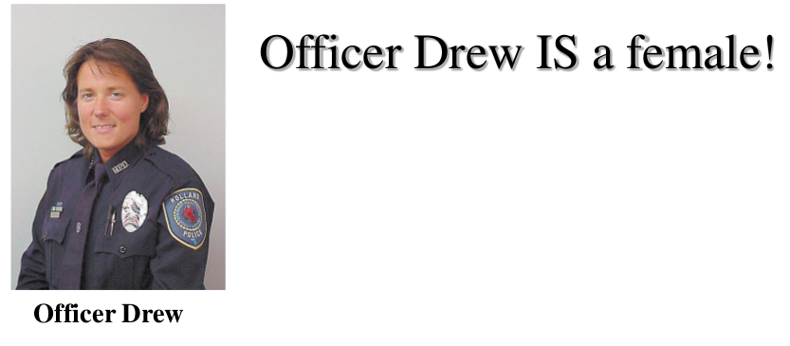
$P\left(male | drew \right)=\frac{P\left(drew | m\right).P(m) }{P(drew)}=\frac{1/3×3/8}{3/8}$=$\frac{1}{3}$
$P\left(female | drew\right)=\frac{P\left(drew | f\right).P(f) }{P(drew)}=\frac{2/5×5/8}{3/8}$=$\frac{2}{3}$

Slide 21
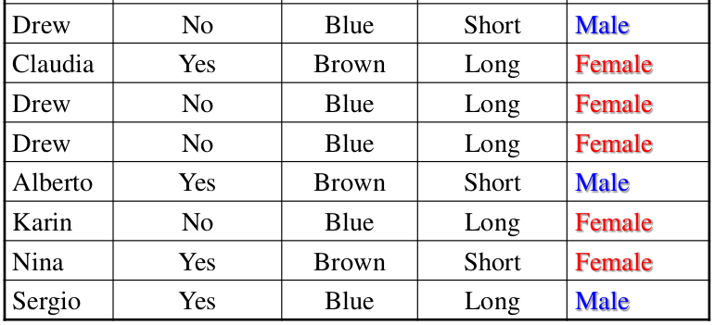
Multiple Input Attributes
So far we have only considered Bayes Classification when we have one attribute (i.e. “name”). But we may have many features.
How do we use all the features?
Name | Over 170cm | Eye | Hair length | Gender

Slide 22
Multiple Input Attributes
Name | Over 170cm | Eye | Hair length | Gender

Slide 23
Naïve Bayes Rule
Recall
$$P\left(A | B\right)∗P\left(B\right)=P\left(A,B\right)=P\left(B,A\right)$$
Bayes Rule
$$P\left(C | F\right)=\frac{P\left(F | C\right)∗P\left(C\right)}{P\left(F\right)}$$
General Bayes Rule:
$$P\left(C | F_{1},…,F_{n}\right)=\frac{P\left(F_{1},…,F_{n} | C\right)∗P\left(C\right)}{P\left(F_{1},…,F_{n}\right)}$$
$$P\left(C | F_{1},…,F_{n}\right)∗P\left(C\right)=P\left(C,F_{1},…,F_{n}\right)$$

Slide 24
Naïve Bayes Rule
Can be re-written using chain rule:
  Consider two variable case as an example:
$$P\left(C,F_{1},F_{2}\right)=P\left(C\right)∗P\left(F_{1},F_{2} | C\right)$$
$$=P\left(C\right)∗P\left(F_{1} | C\right)∗P\left(F_{2} | C,F_{1}\right)$$
For General case
  $P\left(C,F_{1},…,F_{n}\right)=P\left(C\right)∗P\left(F_{1},…,F_{n} | C\right)$
  $P\left(C,F_{1},…,F_{n}\right)=P\left(C\right)∗P\left(F_{1} | C\right)∗P\left(F_{2},…,F_{n} | C,F_{1}\right)$
  $P\left(C,F_{1},…,F_{n}\right)=P\left(C\right)∗P\left(F_{1} | C\right)∗P\left(F_{2} | C,F_{1}\right)∗P\left(F_{3},…,F_{n} | C,F_{1},F_{2}\right)$
  $=P\left(C\right)×P\left(F_{1} | C\right)×P\left(F_{2} | C,F_{1}\right)×…×P\left(F_{n} | C,F_{1},…,F_{n−1}\right)$

Slide 25
Naïve Bayes assumption
Let
  $P\left(F_{2} | C,F_{1}\right)=P\left(F_{2} | C\right)$ and
  $P\left(F_{n} | C,F_{1},…,F_{n−1}\right)=P\left(F_{n} | C\right)$
$P\left(C,F_{1},…,F_{n}\right)=$ $P\left(C\right)×P\left(F_{1} | C\right)×P\left(F_{2} | C\right)×…×P\left(F_{n} | C\right)$
$P\left(C,F_{1},…,F_{n}\right)=$ $P\left(C\right)× \prod_{i=1}^{n}{P(F_{i}|C)}$
Naïve yet a very useful assumption
It dramatically reduces the number of parameters in the model, while still leading to a model that can be quite effective in practice.

Slide 26
Naïve Bayes Rule
To simplify the task, Naïve Bayesian classifiers assume attributes have independent distributions, and thereby estimate
$$P\left(C | F_{1},…,F_{n}\right)=\frac{P\left(F_{1},…,F_{n}|C\right)×P(C)}{P\left(F_{1},…{,F}_{n}\right)}$$
$$P\left(C | F_{1},…,F_{n}\right)=\frac{P\left(C\right)×P\left(F_{1} | C\right)×P\left(F_{2} | C\right)×…×P\left(F_{n} | C\right)}{P\left(F_{1},…{,F}_{n}\right)}$$
$$=P\left(C_{i}\right).\prod_{j=1}^{n}{P(F_{j}|C_{i})}$$
$${Classifier}_{NB}=argmax P\left(c_{i}\right).\prod_{j=1}^{n}{P(f_{j}|c_{i})}$$

Slide 27
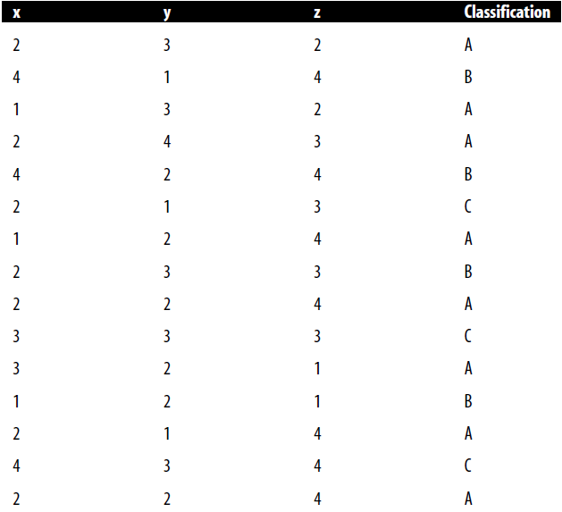
Naïve Bayes classifier - Example
Suppose that data items consists of the attributes x, y, z
  x, y, and z are each integers in the range 1 to 4.
The available classifications are A, B, and C.

Slide 28

Naïve Bayes classifier - Example
15 pieces of training data, each of which has been classified.
Eight of the training data are classified as A, four as B, and three as C.
Suppose that we are presented with a new piece of data.
  $$x=2, y=3, z=4$$
Classify it using Naïve Bayes
First: we must now calculate each of the following:
  P(A|x,y,z) = P(A) . P(x = 2|A) . P(y = 3|A) . P(z = 4|A)
  P(B|x,y,z) = P(B) . P(x = 2|B) . P(y = 3|B) . P(z = 4|B)
  P(C|x,y,z) = P(C) . P(x = 2|C) . P(y = 3|C) . P(z = 4|C)

Slide 29
Naïve Bayes classifier - Example
Probabilities will be calculated from training set:
The posterior probability of A, i.e. P(A|x,y,z):
  P(A).P(x = 2|A).P(y = 3|A).P(z = 4|A)
  =$\frac{8}{15}.\frac{5}{8}.\frac{2}{8}.\frac{4}{8}=0.0417$
The posterior probability for B, i.e. P(B|x,y,z):
  P(B) . P(x = 2|B) . P(y = 3|B) . P(z = 4|B)
  = $\frac{4}{15}.\frac{1}{4}.\frac{1}{4}.\frac{2}{4}=0.0083$
The posterior probability for C, i.e. P(C|x,y,z):
  P(C|x,y,z) = P(C) . P(x = 2|C) . P(y = 3|C) . P(z = 4|C)
  = $\frac{3}{15}.\frac{1}{3}.\frac{2}{3}.\frac{1}{3}=0.015$
Hence, category A is chosen as the best category for this new piece of data, with category C as the second best choice.

Slide 30
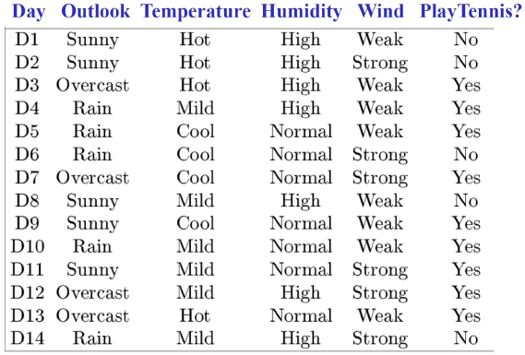
Example: Training Dataset

Slide 31
Supervised Classification
Now assume that we have to classify the following new instance:
Key idea: compute a probability for each class based on the probability distribution in the training data.
First take into account the probability of each attribute. Treat all attributes equally important, i.e., multiply the probabilities.
Now take into account the overall probability of a given class. Multiply it with the probabilities of the attributes.
Now choose the class so that it maximizes this probability. This means that the new instance will be classified as YES or NO.
Outlook | Temperature | Humidity | Windy | Play
Sunny | Cool | High | Strong | ?

Slide 32
Outlook
 | Yes | No | P(Yes) | P(No)
Sunny | 2 | 3 | 2/9 | 3/5
Overcast | 4 | 0 | 4/9 | 0/5
Rainy | 3 | 2 | 3/9 | 2/5
Total | 9 | 5 | 100% | 100%
Temperature
 | Yes | No | P(Yes) | P(No)
Hot | 2 | 2 | 2/9 | 2/5
Mild | 4 | 2 | 4/9 | 2/5
Cool | 3 | 1 | 3/9 | 1/5
Total | 9 | 5 | 100% | 100%
Humidity
 | Yes | No | P(Yes) | P(No)
High | 3 | 4 | 3/9 | 4/5
Normal | 6 | 1 | 6/9 | 1/5
Total | 9 | 5 | 100% | 100%
Wind
 | Yes | No | P(Yes) | P(No)
False | 6 | 2 | 6/9 | 2/5
True | 3 | 3 | 3/9 | 3/5
Total | 9 | 5 | 100% | 100%
Play |  | P(Yes) / P(No)
Yes | 9 | 9/14
No | 5 | 5/14
Total | 14 | 100%

Slide 33
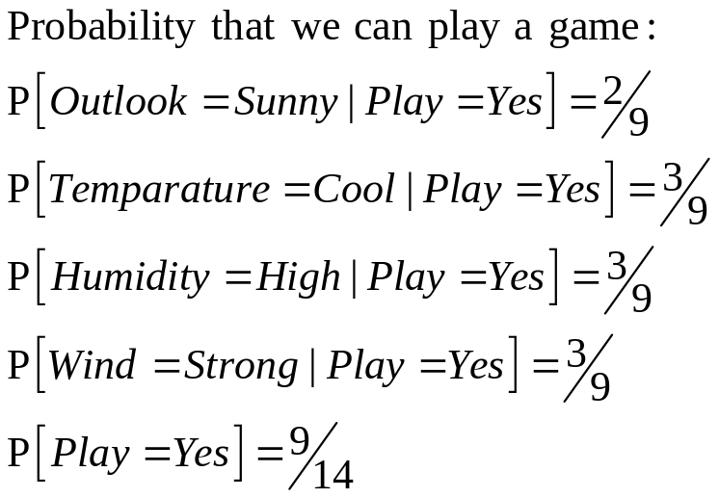
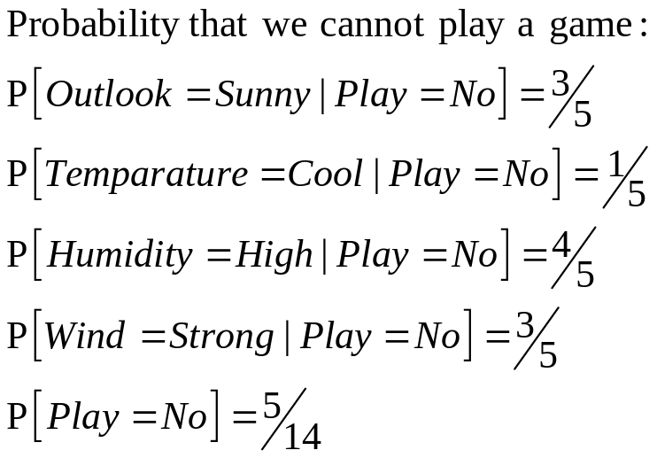
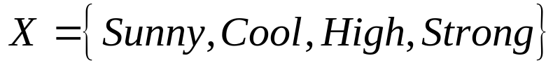
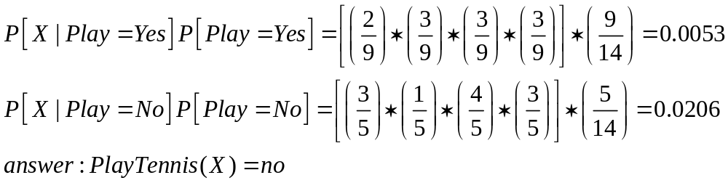
Supervised Classification: Using Naïve Bayes

Slide 34
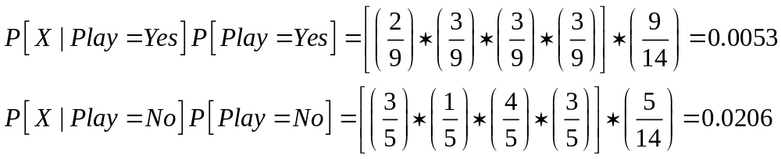
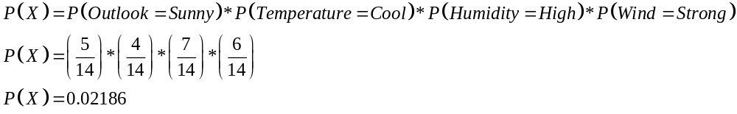
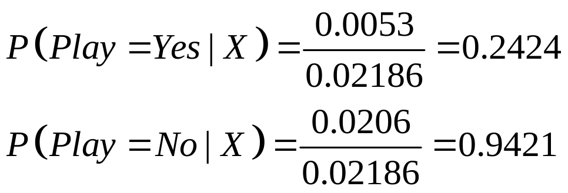
Supervised Classifeir: Using Bayes
Dividing the result by overall evidence

Slide 35
Question
For the given dataset, apply naïve Bayes algorithm to compute the prediction for a car with attributes
  $\left\{Red, Domestic, SUV\right\}$
Color | Type | Origin | Stolen
Red | Sports | Domestic | Yes
Red | Sports | Domestic | No
Red | Sports | Domestic | Yes
Yellow | Sports | Domestic | No
Yellow | Sports | Imported | Yes
Yellow | SUV | Imported | No
Yellow | SUV | Imported | Yes
Yellow | SUV | Domestic | No
Red | SUV | Imported | No
Red | Sports | Imported | Yes

Slide 36
Question
Consider the given dataset. Apply Naïve Bayes Algorithm and predict that if a fruit with following properties $\left\{Yellow, Sweet, Long\right\}$
Fruit | Yellow | Sweet | Long | TOTAL
Mango | 350 | 450 | 0 | 650
Banana | 400 | 300 | 350 | 400
Others | 50 | 100 | 50 | 150
TOTAL | 800 | 850 | 400 | 1200

Slide 37
Example: Witness Reliability
In the city of Cambridge, there are two taxi companies. One taxi company uses yellow taxis, and the other uses white taxis. The yellow taxi company has 90 cars, and the white taxi company has just 10 cars. A hit-and-run incident has been reported, and an eye witness has stated that she is certain that the car was a white taxi. experts have asserted that given the foggy weather at the time of the incident, the witness had a 75% chance of correctly identifying the taxi.
Given that the lady has said that the taxi was white, what is the likelihood that she is right?

Slide 38
Example: Witness Reliability
P(Y) = 0.9 (the probability of any particular taxi being yellow)
P(W) = 0.1 (the probability of any particular taxi being white)
Let us denote by
  P(C_{W}) the probability that the culprit was driving a white taxi
  P(C_{Y}) the probability that it was a yellow car
  P(W_{W}) to denote the probability that the witness says she saw a white car
  P(W_{Y}) to denote that she says she saw a yellow car
Now, if the witness really saw a yellow car, she would say that it was yellow 75% of the time, and if she says she saw a white car, she would say it was white 75% of the time, So
  P(W_{W}| C_{W}) =0.75
  P(W_{Y} | C_{Y}) = 0.75

Slide 39

Example: Witness Reliability
we can apply Bayes’ theorem to find the probability, given that she is saying that the car was white, that she is correct:
We now need to calculate P(WW)—the prior probability that the lady would say she saw a white car.
Suppose that the lady is shown a random sequence of 1000 cars.
We expect 900 of these cars to be yellow and 100 of them to be white.
The witness will misidentify 250 of the cars:
  Of the 900 yellow cars, she will incorrectly say that 225 are white.
  Of the 100 white cars, she will incorrectly say that 25 are yellow.
  Hence, in total, she will believe she sees 300 white

Slide 40
Example: Witness Reliability
we can apply Bayes’ theorem to find the probability, given that she is saying that the car was white, that she is correct:
We now need to calculate P(W_{W})—the prior probability that the lady would say she saw a white car.
Suppose that the lady is shown a random sequence of 1000 cars.
We expect 900 of these cars to be yellow and 100 of them to be white.
The witness will misidentify 250 of the cars:
  Of the 900 yellow cars, she will incorrectly say that 225 are white.
  Of the 100 white cars, she will incorrectly say that 25 are yellow.
  Hence, in total, she will believe she sees 300 white cars instead of 100.
P(W_{W}) is 300/1000 = 0.3.

Slide 41
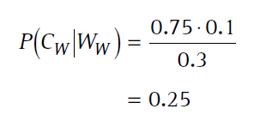
Example: Witness Reliability
We can now complete our equation to find P(C_{W}|W_{W}):
In other words, if the lady says that the car was white, the probability that it was in fact white is only 0.25
It is three times more likely that it was actually yellow!

Slide 42
Example
person | Covid(yes/no) | Flu(yes/no) | Fever(yes/no)
1 | Yes | No | Yes
2 | No | Yes | Yes
3 | Yes | Yes | Yes
4 | No | No | No
5 | Yes | No | Yes
6 | No | No | Yes
7 | Yes | No | Yes
8 | Yes | No | No
9 | No | Yes | Yes
10 | no | yes | no
Given: flu,covid?

Slide 43
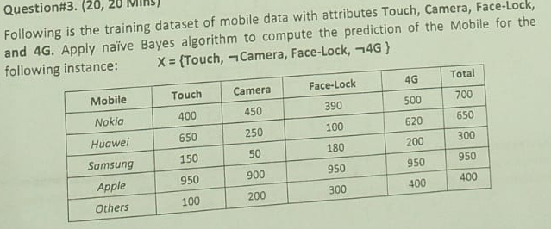

Slide 44
